Slide 1



using docker Part 5: setting up flux.1 with hugging face spaces

Slide 2
What you will learn
What is FLUX.1?
Getting Your Hugging Face Account
Getting Your Access Token
Picking the Model
Going to Spaces
What is Zero GPU?
Duplicating the Space
Accessing Your Space with Code

Slide 3
What is flux.1?

Slide 4
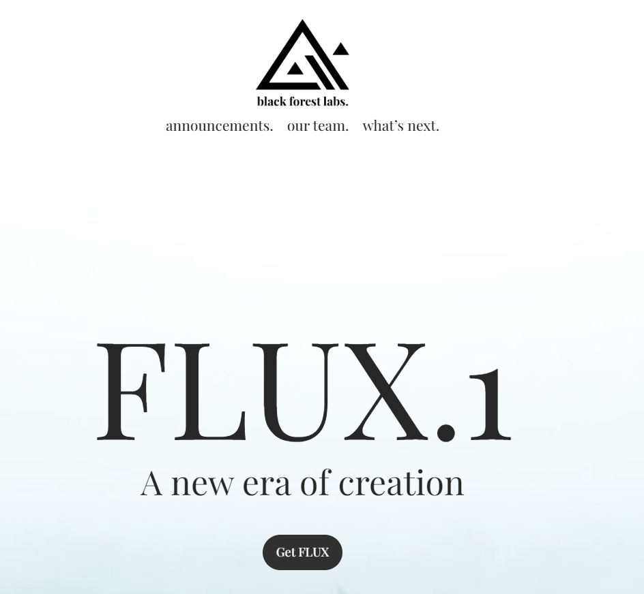
Notes:
https://blackforestlabs.ai/

Slide 5
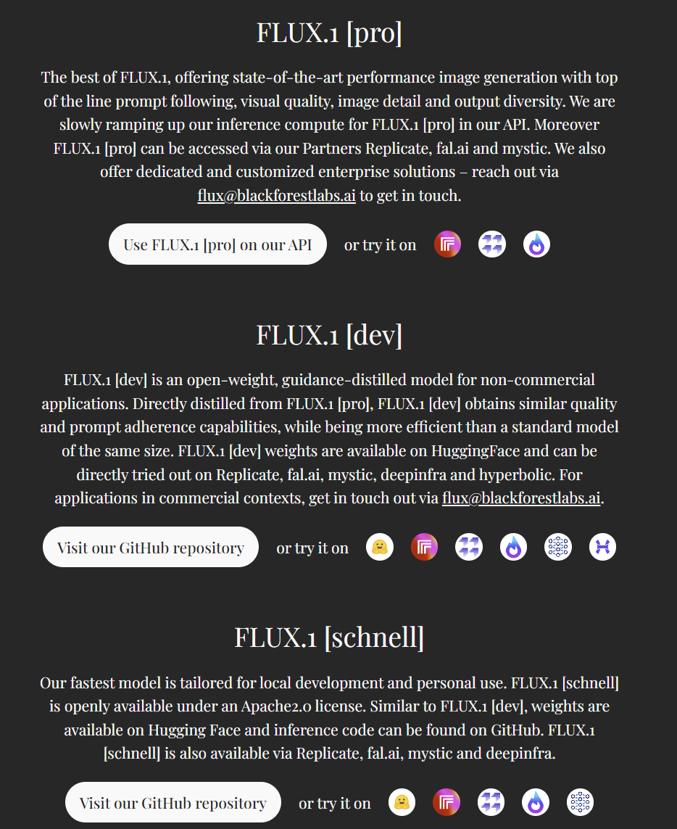
Notes:
https://blackforestlabs.ai/#get-flux

Slide 6
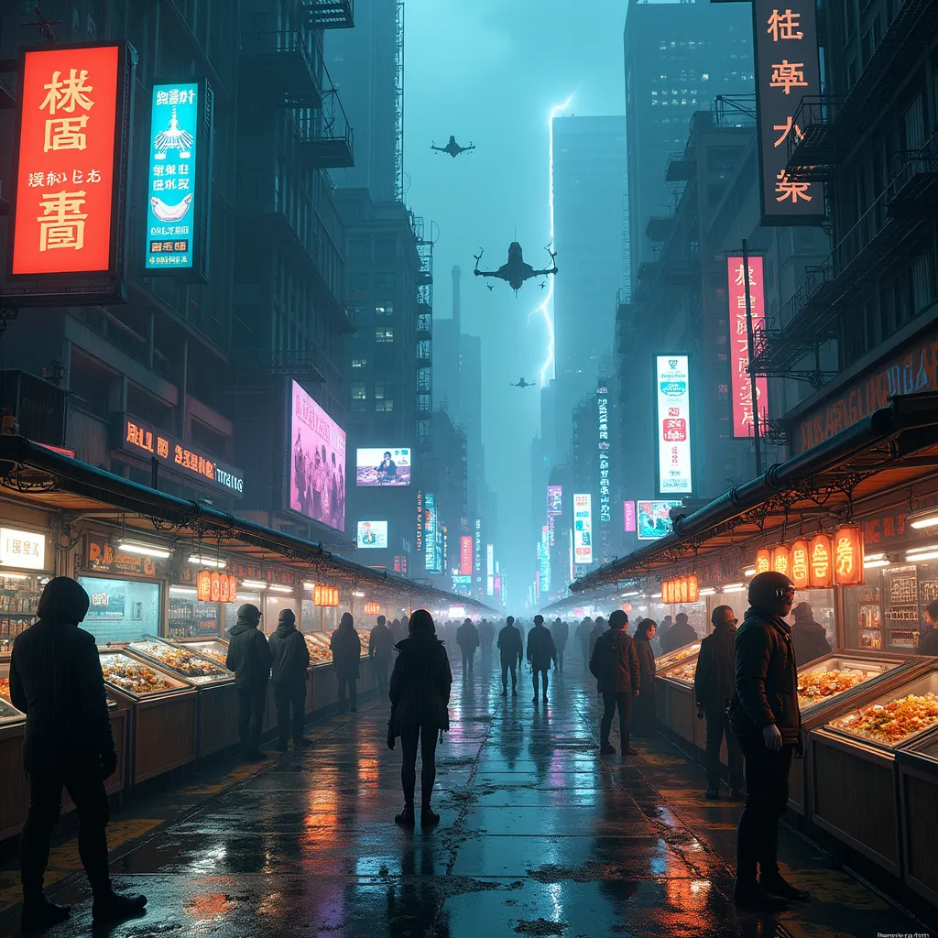
Notes:
Post-apocalyptic Cyberpunk Night Market: Picture a bustling, chaotic street market deep within the heart of a crumbling city, set in a dystopian future. The sky above is a thick, polluted haze that glows neon from the endless advertisements projected onto towering, decaying skyscrapers. The buildings surrounding the market are a mix of high-tech and rundown, with exposed wiring, rusting metal, and glowing digital billboards, flashing in a mix of blues, purples, and greens.
The market is packed with a diverse array of beings—humans, androids, and cybernetic creatures—all interacting under the cold neon lights. Stalls are lit with holographic displays, showcasing everything from glowing mechanical body parts to exotic alien foods and black-market tech. The vendors, some human and others robotic, display their wares behind protective glass, with robotic arms reaching out to customers. In the background, small flying drones buzz around, advertising illicit deals or scanning for troublemakers.
Above, sleek, dark hovercars zoom by, leaving behind trails of light, while towering billboards reflect off puddles of rain-soaked pavement, giving the scene a glossy, reflective texture. Steam rises from manholes and food stalls, mixing with the rain, creating an eerie, almost dreamlike atmosphere. In the distance, towering skyscrapers disappear into the smog, illuminated by distant lightning flashes from an impending storm.
At the center of the market, a shady, neon-lit alleyway branches off, leading to secretive underground deals—cyber-hackers, smugglers, and mercenaries exchanging goods. A low hum of electronic music and chatter fills the air, as the people of this dystopia try to survive in a world where technology has overtaken humanity.

Slide 7
Getting your hugging face account

Slide 8

Notes:
https://huggingface.co/

Slide 9

Notes:
https://huggingface.co/join

Slide 10
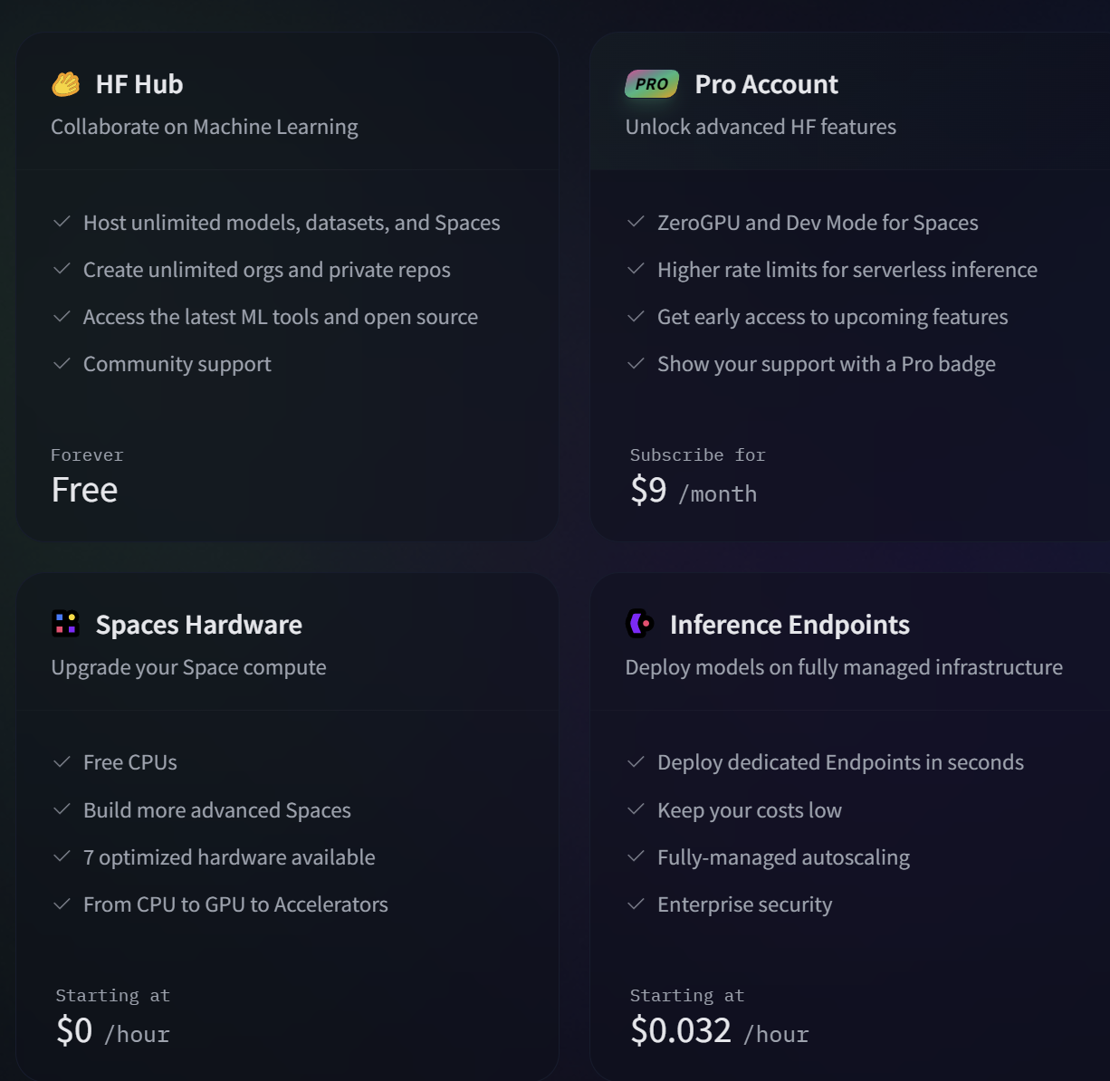
Notes:
https://huggingface.co/pricing

Slide 11
Getting Your Access Token

Slide 12
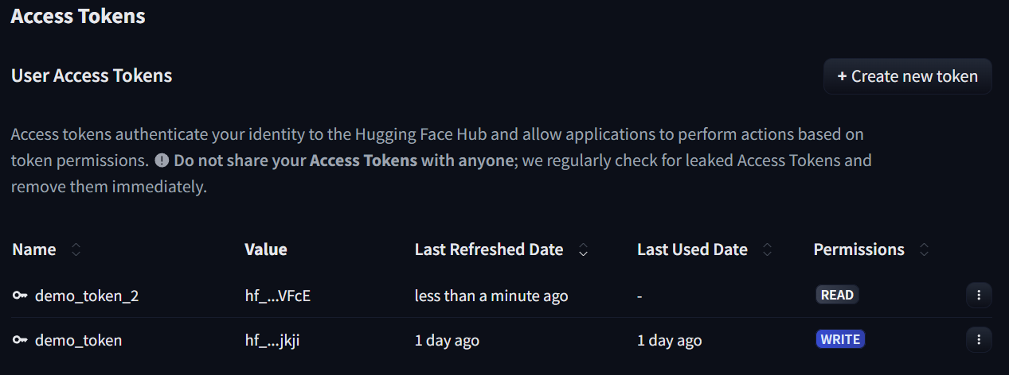
Notes:
https://huggingface.co/settings/tokens

Slide 13
Picking the model

Slide 14
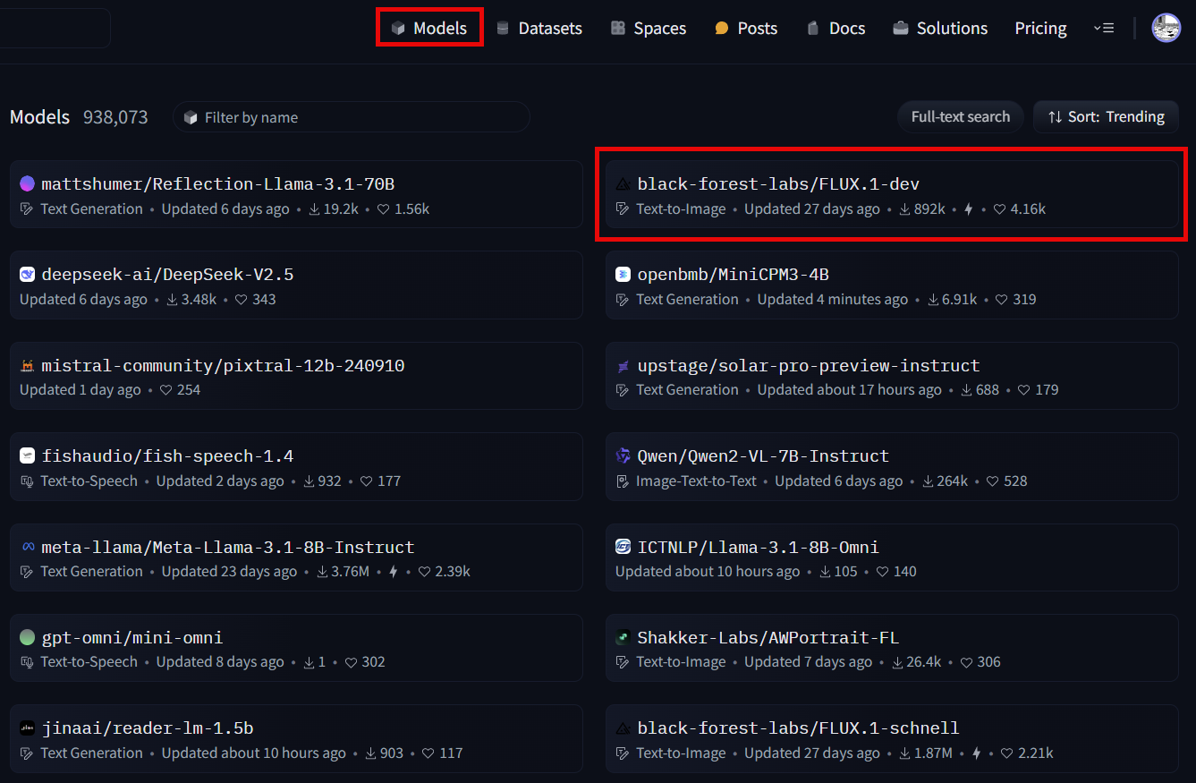
Notes:
https://huggingface.co/black-forest-labs/FLUX.1-dev

Slide 15
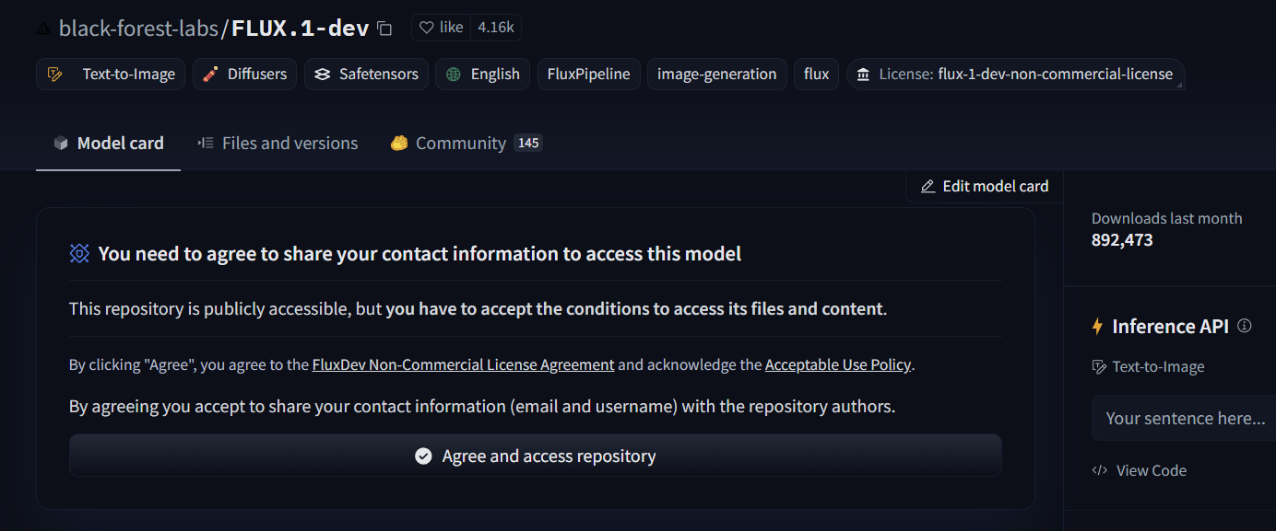

Slide 16
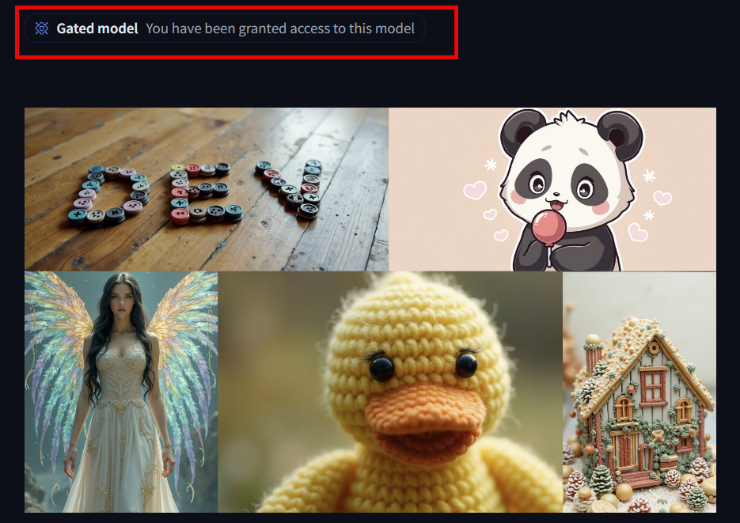

Slide 17
Going to spaces

Slide 18
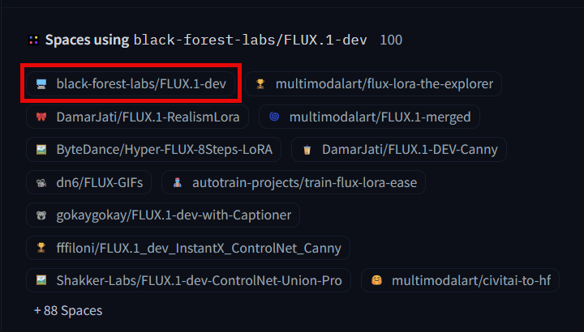
Notes:
https://huggingface.co/black-forest-labs/FLUX.1-dev

Slide 19
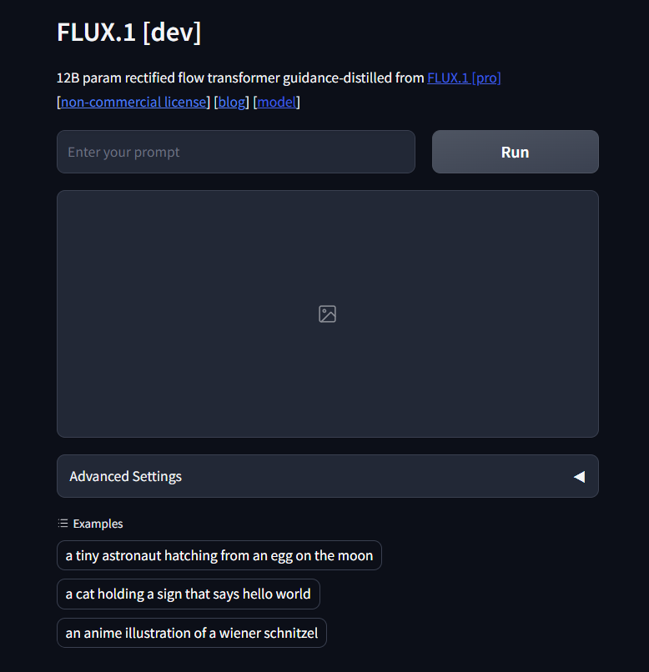
Notes:
https://huggingface.co/spaces/black-forest-labs/FLUX.1-dev

Slide 20
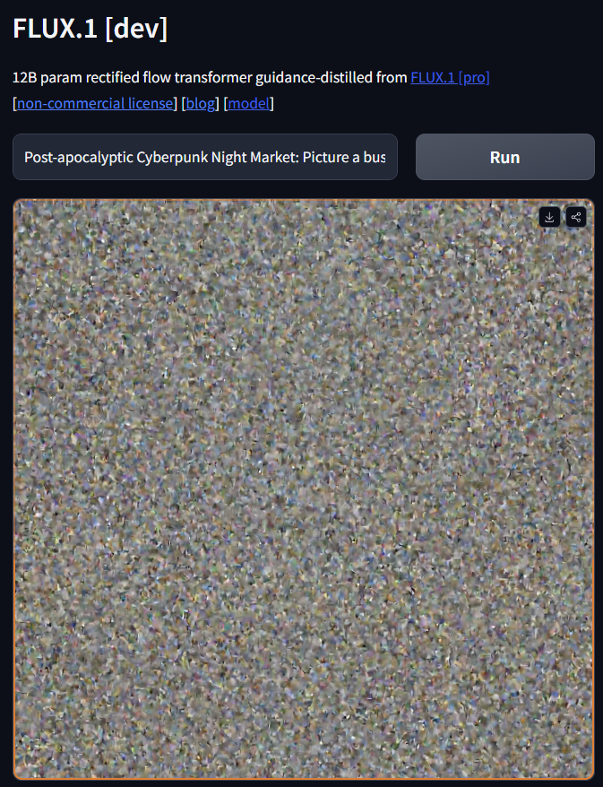
Notes:
Post-apocalyptic Cyberpunk Night Market: Picture a bustling, chaotic street market deep within the heart of a crumbling city, set in a dystopian future. The sky above is a thick, polluted haze that glows neon from the endless advertisements projected onto towering, decaying skyscrapers. The buildings surrounding the market are a mix of high-tech and rundown, with exposed wiring, rusting metal, and glowing digital billboards, flashing in a mix of blues, purples, and greens.
The market is packed with a diverse array of beings—humans, androids, and cybernetic creatures—all interacting under the cold neon lights. Stalls are lit with holographic displays, showcasing everything from glowing mechanical body parts to exotic alien foods and black-market tech. The vendors, some human and others robotic, display their wares behind protective glass, with robotic arms reaching out to customers. In the background, small flying drones buzz around, advertising illicit deals or scanning for troublemakers.
Above, sleek, dark hovercars zoom by, leaving behind trails of light, while towering billboards reflect off puddles of rain-soaked pavement, giving the scene a glossy, reflective texture. Steam rises from manholes and food stalls, mixing with the rain, creating an eerie, almost dreamlike atmosphere. In the distance, towering skyscrapers disappear into the smog, illuminated by distant lightning flashes from an impending storm.
At the center of the market, a shady, neon-lit alleyway branches off, leading to secretive underground deals—cyber-hackers, smugglers, and mercenaries exchanging goods. A low hum of electronic music and chatter fills the air, as the people of this dystopia try to survive in a world where technology has overtaken humanity.

Slide 21
What is zero gpu?

Slide 22
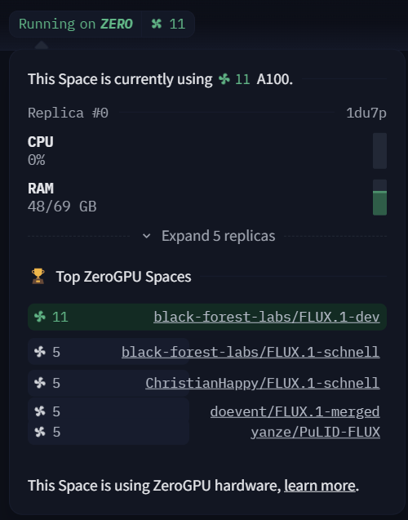

Slide 23
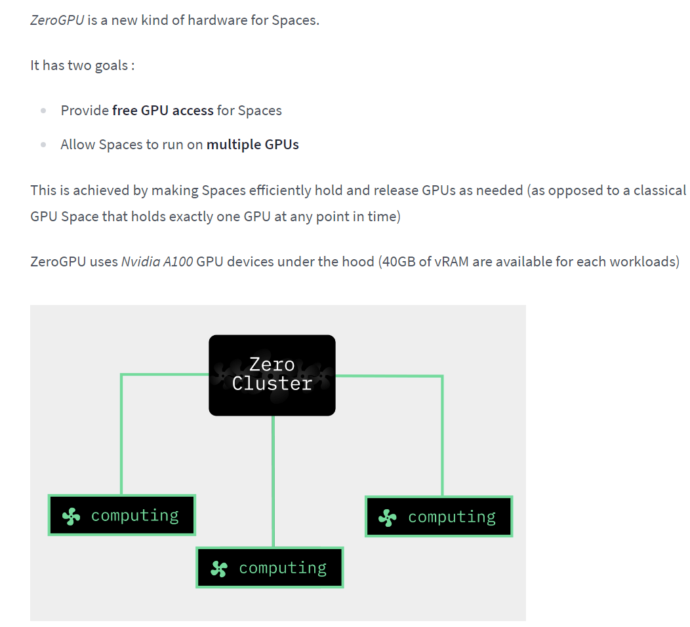
Notes:
https://huggingface.co/spaces/zero-gpu-explorers/README

Slide 24
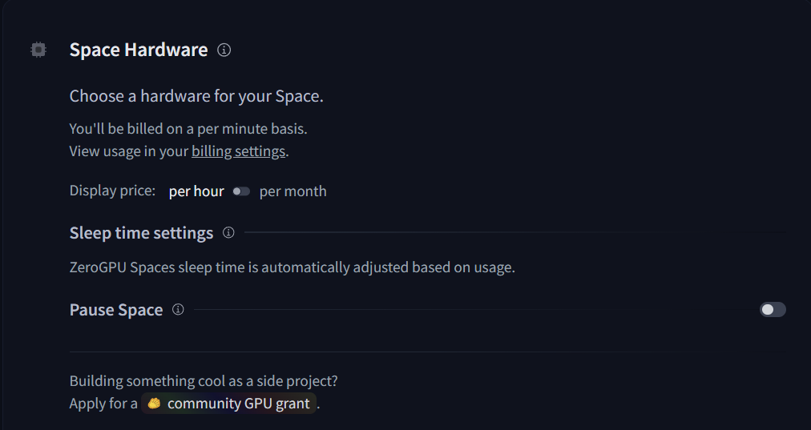

Slide 25
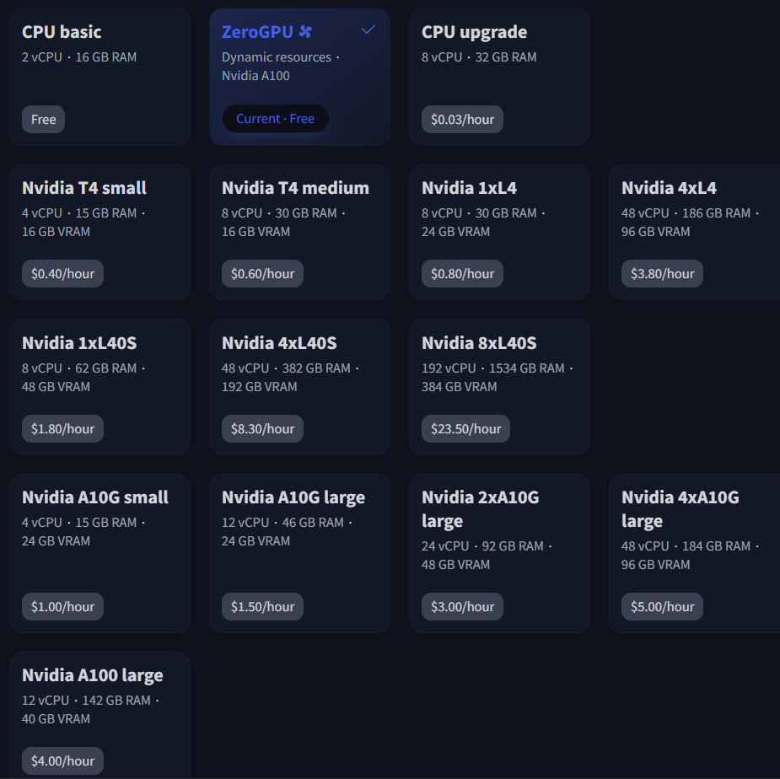

Slide 26
duplicating the space

Slide 27
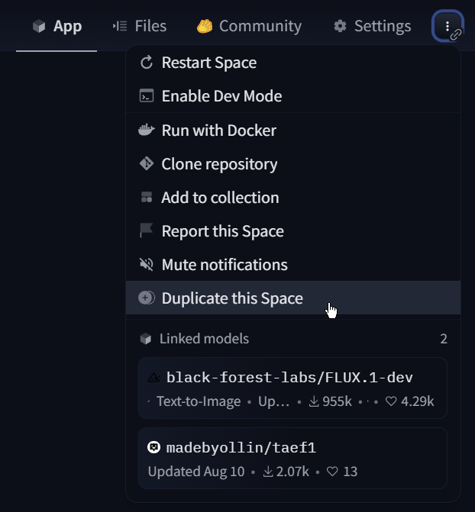
Notes:
https://huggingface.co/spaces/suspicious-cow/FLUX.1-dev

Slide 28
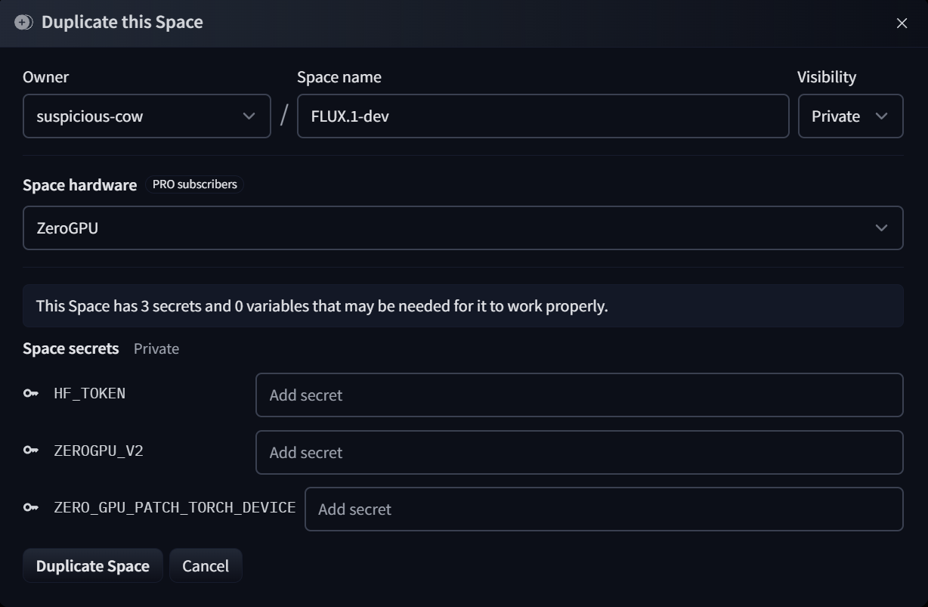
Notes:
https://huggingface.co/spaces/suspicious-cow/FLUX.1-dev?duplicate=true

Slide 29
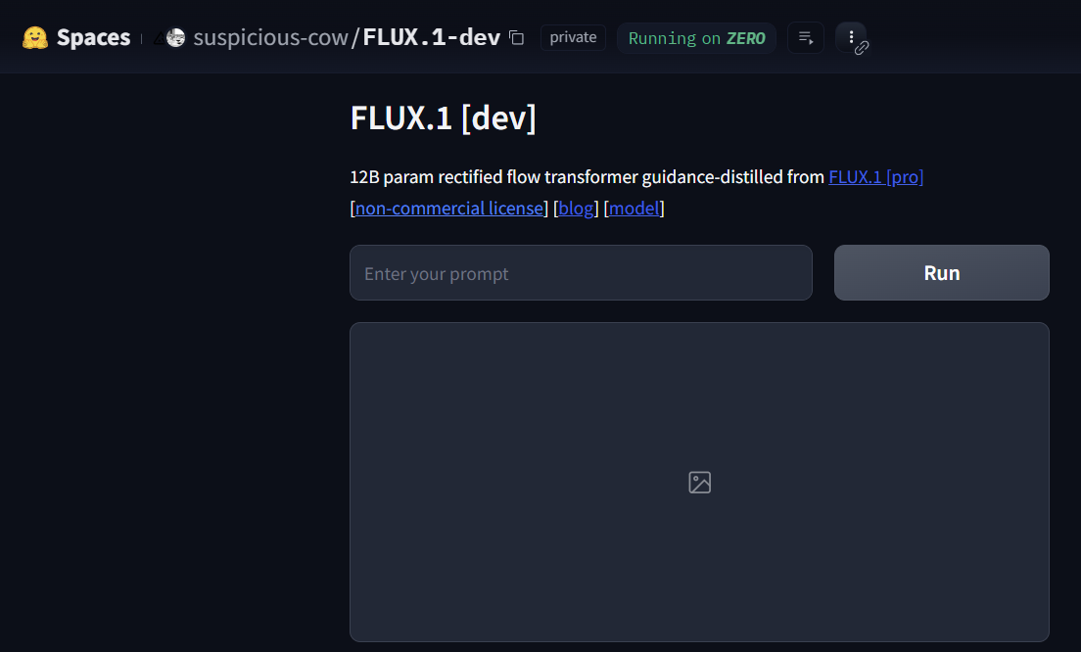

Slide 30
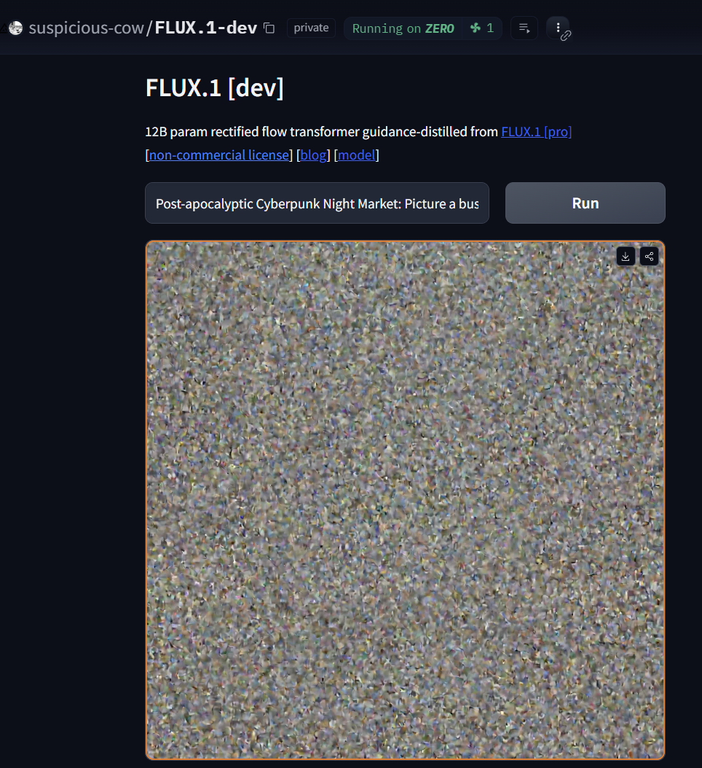
Notes:
Post-apocalyptic Cyberpunk Night Market: Picture a bustling, chaotic street market deep within the heart of a crumbling city, set in a dystopian future. The sky above is a thick, polluted haze that glows neon from the endless advertisements projected onto towering, decaying skyscrapers. The buildings surrounding the market are a mix of high-tech and rundown, with exposed wiring, rusting metal, and glowing digital billboards, flashing in a mix of blues, purples, and greens.
The market is packed with a diverse array of beings—humans, androids, and cybernetic creatures—all interacting under the cold neon lights. Stalls are lit with holographic displays, showcasing everything from glowing mechanical body parts to exotic alien foods and black-market tech. The vendors, some human and others robotic, display their wares behind protective glass, with robotic arms reaching out to customers. In the background, small flying drones buzz around, advertising illicit deals or scanning for troublemakers.
Above, sleek, dark hovercars zoom by, leaving behind trails of light, while towering billboards reflect off puddles of rain-soaked pavement, giving the scene a glossy, reflective texture. Steam rises from manholes and food stalls, mixing with the rain, creating an eerie, almost dreamlike atmosphere. In the distance, towering skyscrapers disappear into the smog, illuminated by distant lightning flashes from an impending storm.
At the center of the market, a shady, neon-lit alleyway branches off, leading to secretive underground deals—cyber-hackers, smugglers, and mercenaries exchanging goods. A low hum of electronic music and chatter fills the air, as the people of this dystopia try to survive in a world where technology has overtaken humanity.

Slide 31
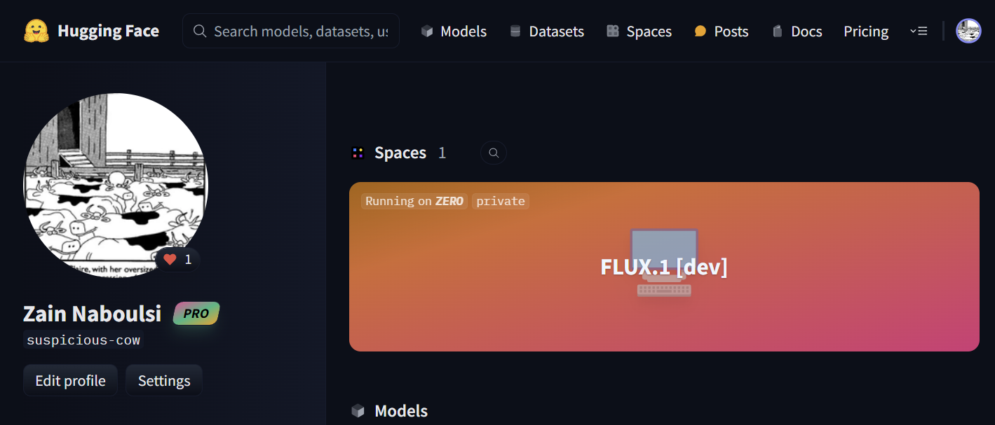

Slide 32
Accessing your space with code

Slide 33
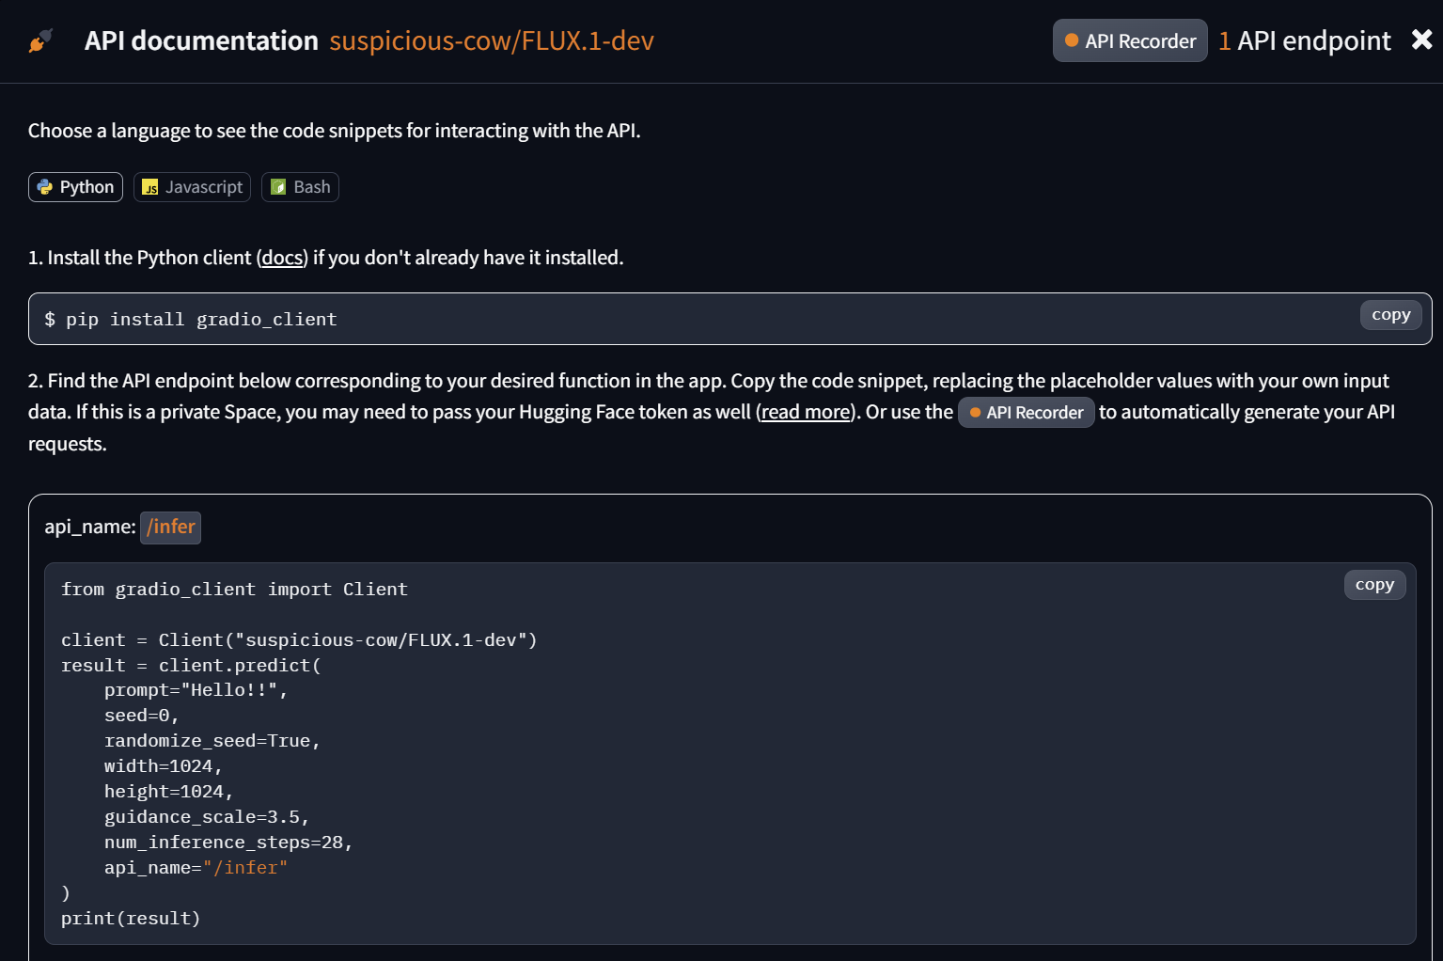

Slide 34
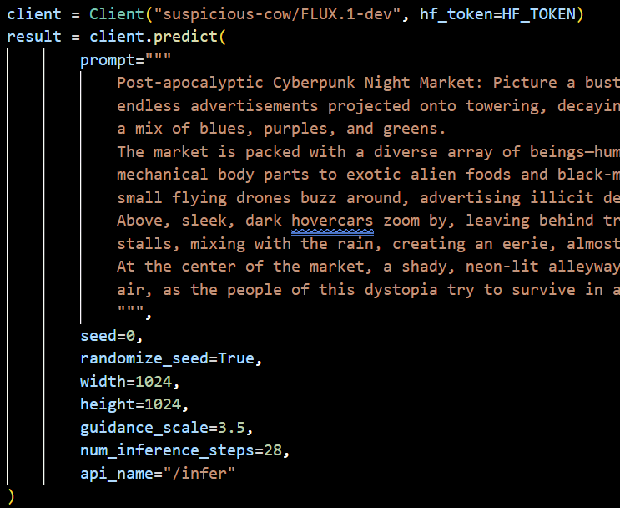

Slide 35


